Slide 1
The European Textiles and Apparel Industry
- trends & strategies
Dirk Vantyghem
EURATEX Director General

Slide 2


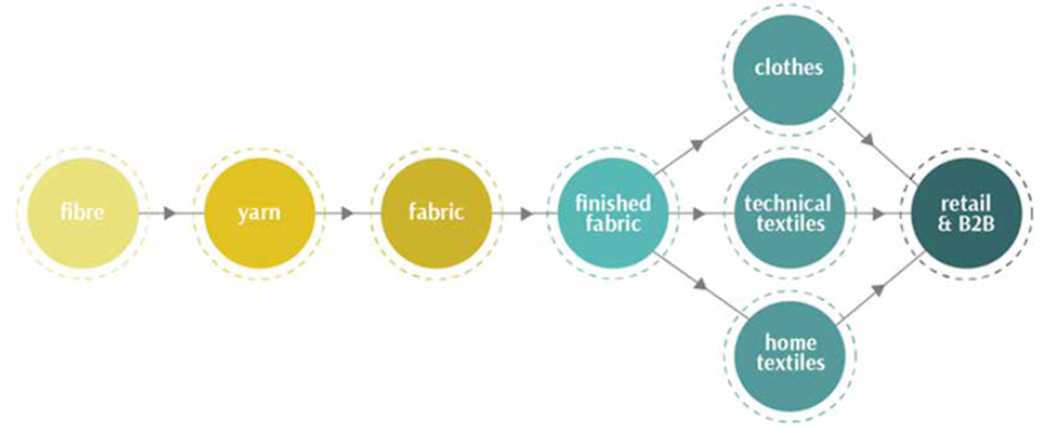
Overview
160,000 companies
€ 162 billion turnover
1,5 million employees
€ 61 billion exports

Slide 3
Overview
Globalised industry & complex supply chains
Very diverse ecosystem
Strong SME focus
Competitiveness based on quality & innovation
Ageing workforce
Sustainable and Circular challenge

Slide 5
Focus on Trade
Europe is the world 2nd most important exporter of T&C, after China
38% of total T&C turnover is sold on global markets
SMEs account for more then 50% of total export value

Slide 8
€ 400mln (rank 24)
€ 250mln (rank 30)

Slide 9
Trade Balances (2019)
Switzerland (+916)
Norway (+86)
Japan (+111)
Singapore (+35)
Macau (+14)
Korea South (+144)
United Kingdom (+365)
United States (+231)
Canada (+80)
South Africa (+4)
Russia (+19)
Ukraine (+33)
Trade Surplus
Serbia (-10)
Hong Kong (-60)
Mexico (-2)
Brazil (-3)
Worsening of
Trade Balance
EU
Tunisia (-0.2)
Morocco (-15)
Turkey (-138)
Sri Lanka (-134)
Myanmar (-664)
Cambodia (-53)
Pakistan (-299)
Bangladesh (-970)
Indonesia (-33)
China (-455)
Vietnam (-291)
Improvement of
Trade Balance
Egypt (+17)
India (+178)
Malaysia (+33)
Philippines (+15)
Thailand (+15)
Taiwan (+20)
Argentina (+14)
Trade Deficit
© EURATEX

Slide 10


More data & analyses: https://euratex.eu/spring-and-autumn-reports/

Slide 11
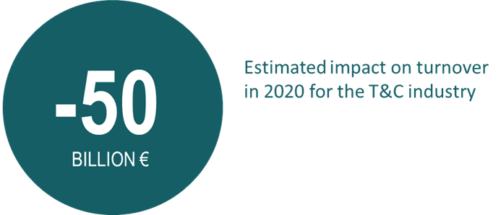
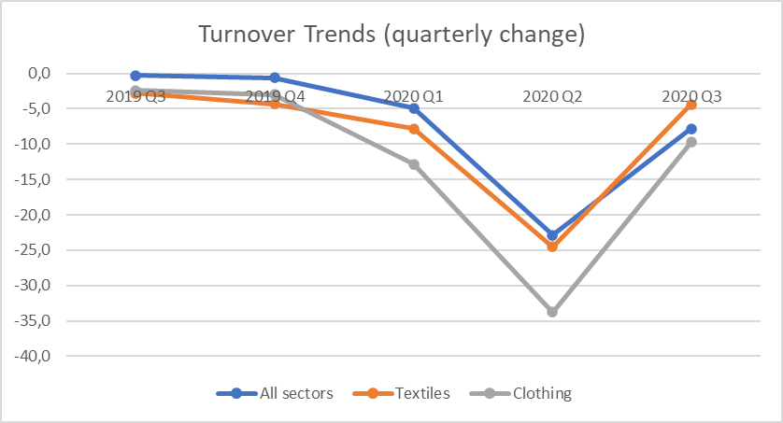
Impact of Covid19

Slide 12
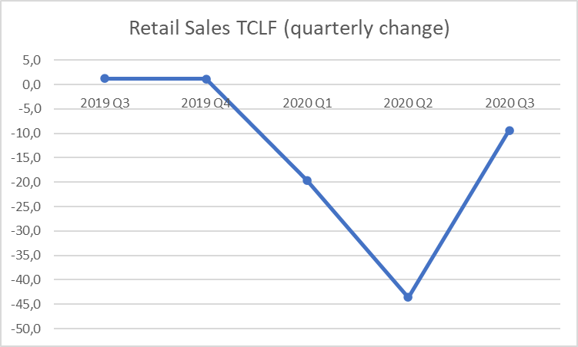
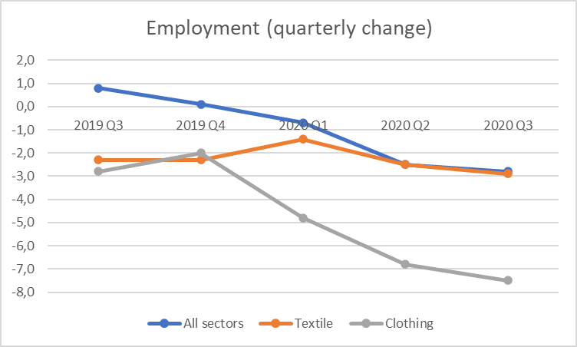
Impact of Covid19
© EURATEX
© EURATEX

Slide 13
Impact of
Covid19
Quarterly Confidence Indicator, EC DG Grow

Slide 14
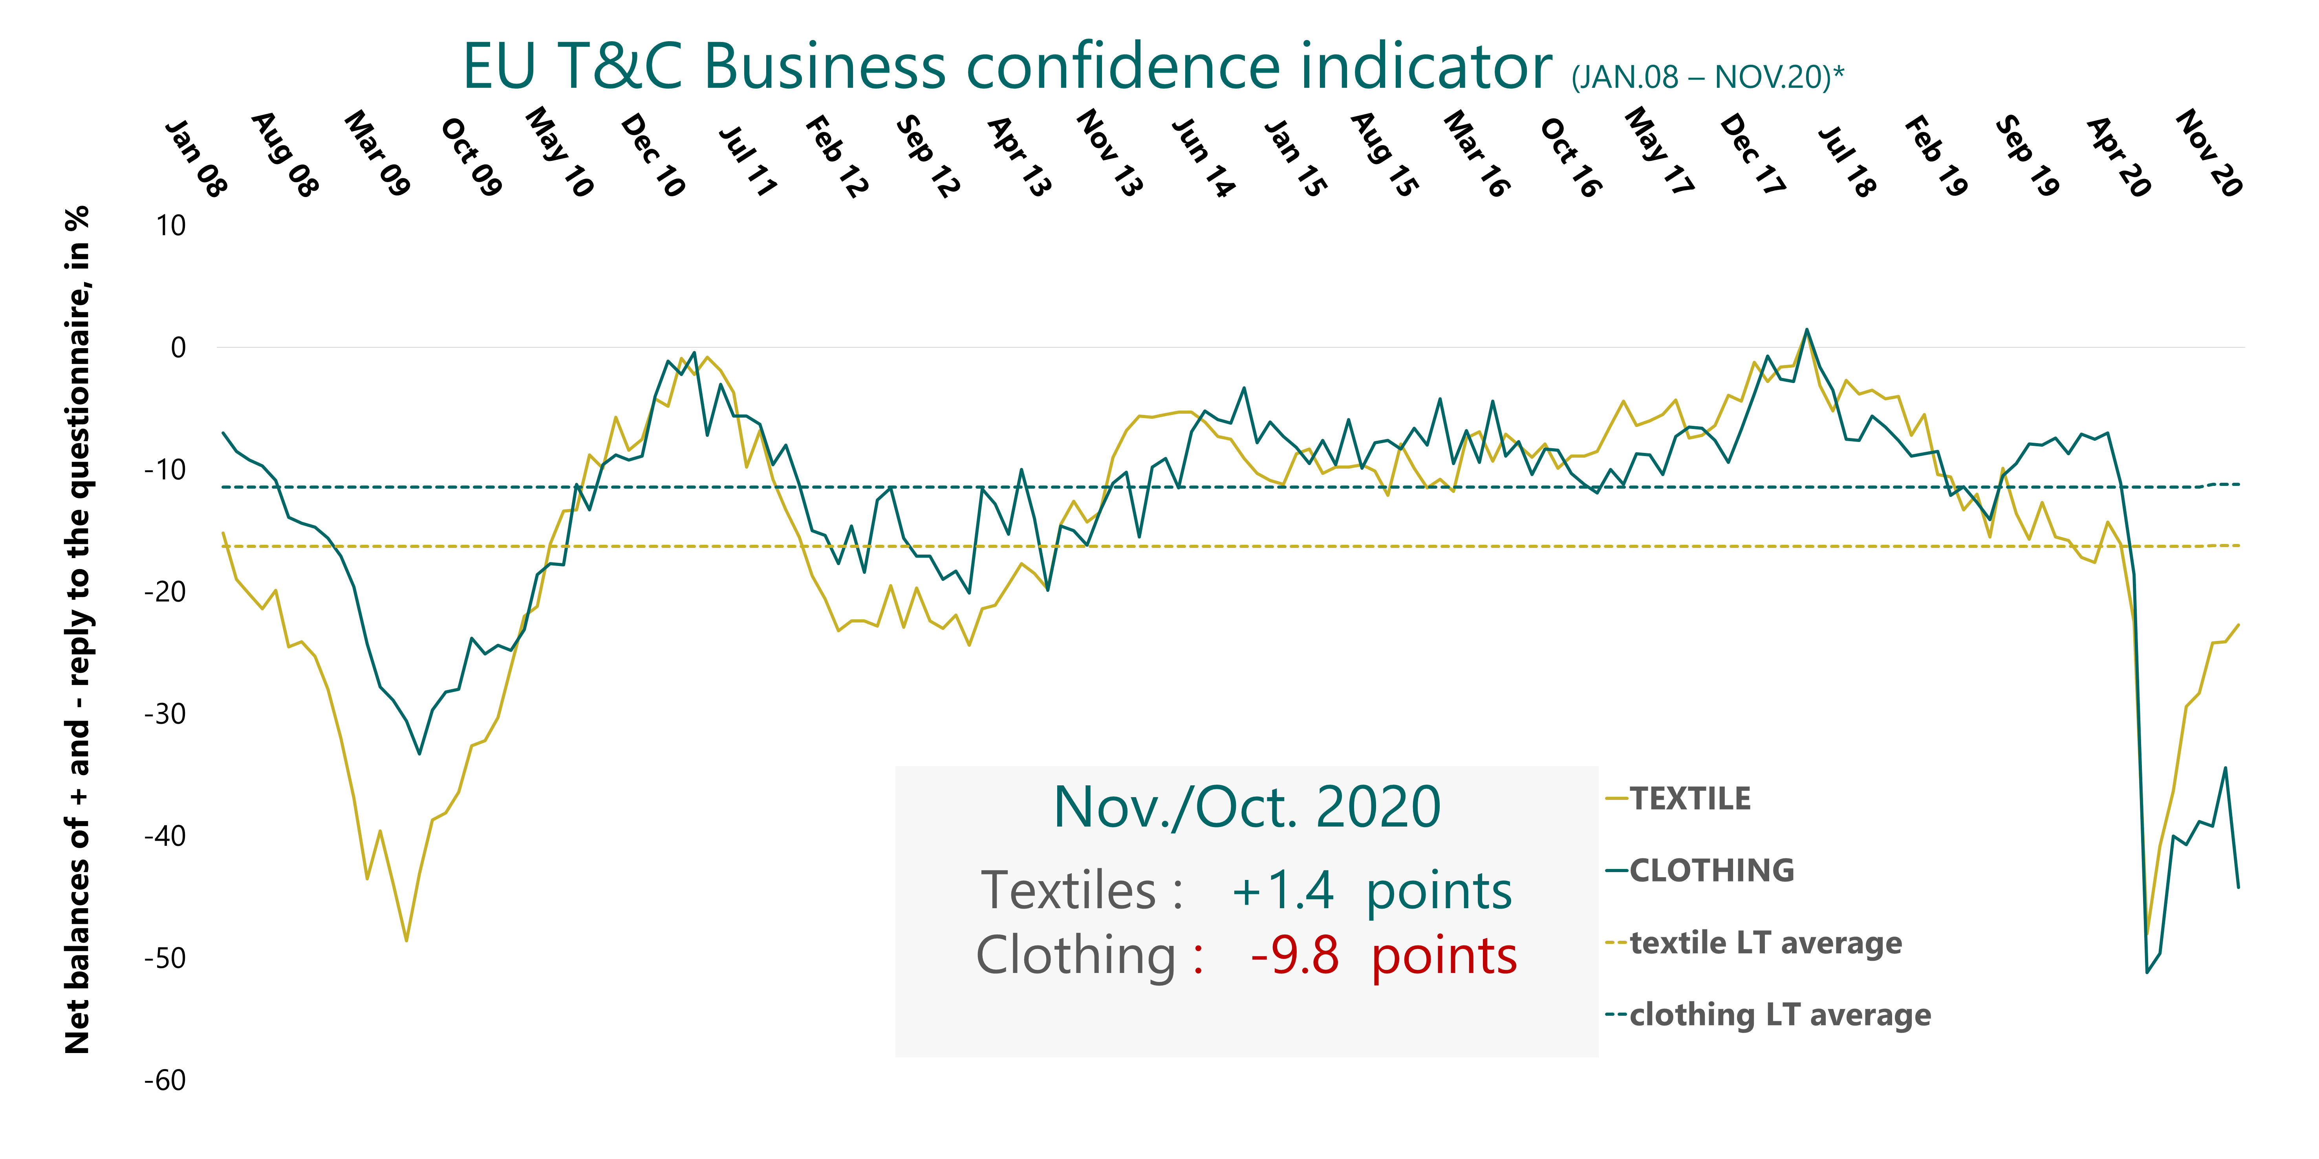
Impact of Covid19
© EC DG Grow

Slide 15
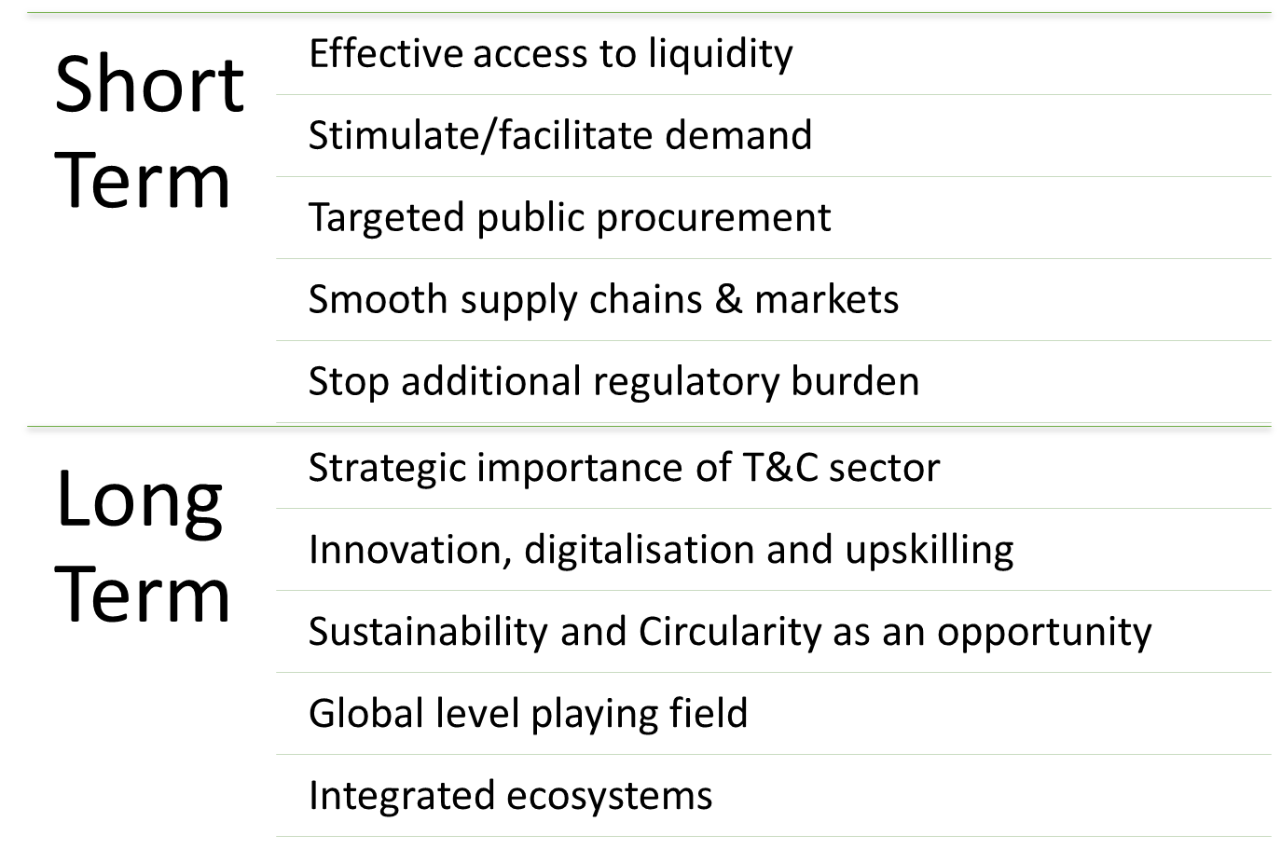

Impact of Covid19

Slide 16
A new EU Textiles Strategy
Sustainability & Circularity
Innovation & Digitalisation
Skills & Start Ups
Markets

Slide 17
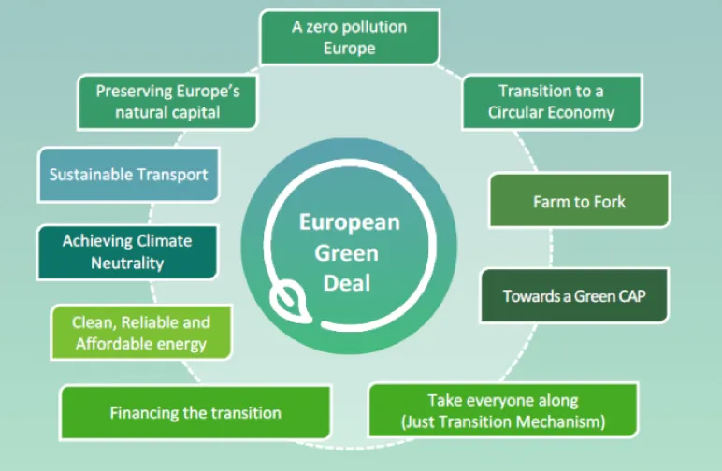
Sustainability and Circular strategy

Slide 18

Focus on circular strategy
EURATEX proposes a collaboration for a new Circular Economy Action Plan for the Textile industry.
Focusing on the roles of the industry, barriers removal, research and innovation and on the types of partnerships that circularity demands.
The EURATEX strategy elaborates on 12 key points, 6 conditions and 38 actions under 9 proposals.

Slide 19
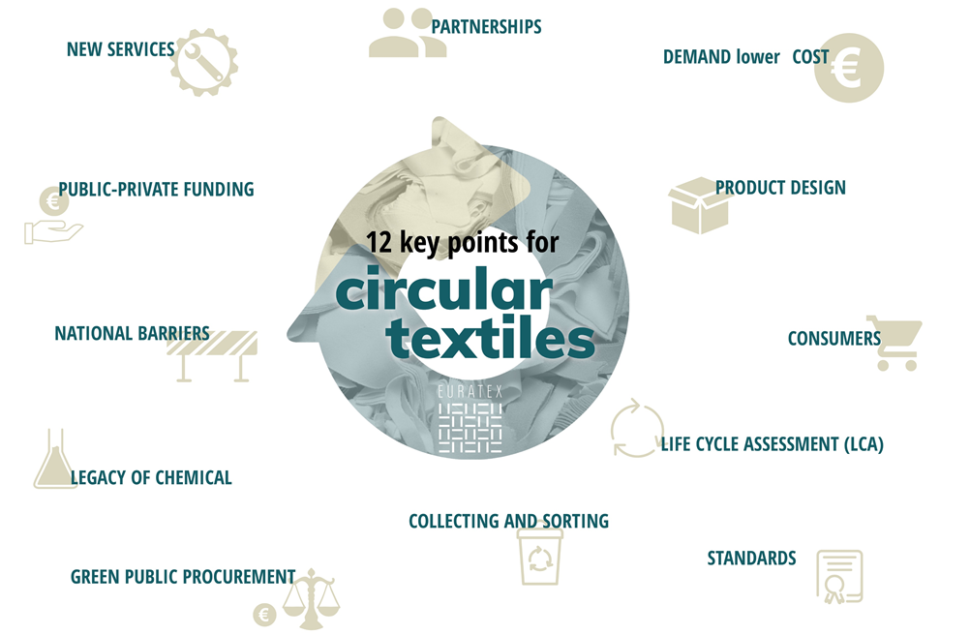

Slide 20
Innovation & Digitalisation

Slide 21
Skills & Entrepreneurship

Slide 22


Skills & Entrepreneurship

Slide 23
Our Trade Agenda
Secure market access in UK, US, Mercosur,…
Implement PEM Convention
More effective market surveillance
Balanced GSP and Due Diligence regulations
Market enforcement
Free & Fair Trade

Slide 24

Thank You
(dirk.vantyghem@euratex.eu)
Visit our website euratex.eu
Follow us on Twitter @euratex_eu

